Slide 1
Borehole Extraction from QDEX Reports

Slide 2
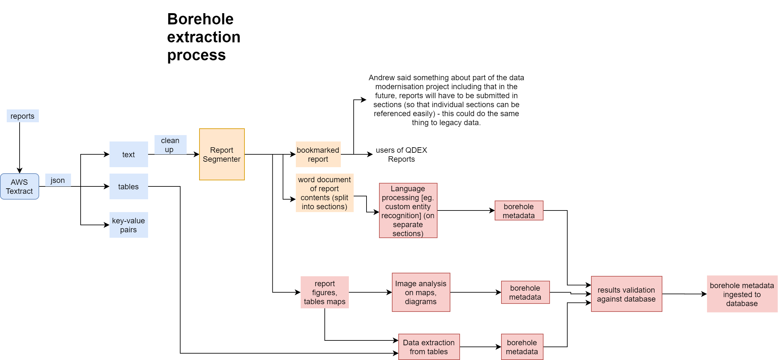

Slide 3
What is a borehole?
- Well, borehole, drillhole, and many other variations – each used by different parts of industry and can have slightly different meanings
- For my purposes: hole that’s been drilled in the ground
  Borehole sounds more legit than just ‘hole’
[add some images, showing they can be big or small]

Slide 4
Borehole extraction from tables rationale
- In reports containing many boreholes, tables can be the best source of complete information of borehole names and locations
  They may appear in text incompletely or not at all, and they may also appear in maps but these are more difficult to interpret
- However, in petroleum reports, well information will be all through the report so these can be treated much differently from coal and mineral reports
  This is partly to do with legislation surrounding reporting requirements: they are much more in-depth for petroleum.

Slide 5
Borehole extraction from tables method
- Have developed a method which gets all the tables, and using lists of known borehole and location column names, tries to find an exact match
  This may be improved by:
    Going through more documents, to find more different column names, expanding the search terms
    Using fuzzier matching – like trying to match from a bag of possible words, or allowing the column name to be a few characters different (to allow for OCR or spelling error)
    Searching not just the first row of the table (which is expected to contain column names) but also one or two down, in case of weirdness in table extraction

Slide 6
Borehole extraction from table types
From a Well Card
From a traditional table
- Well card may or may not be recognised as a table (or parts of it may be cut off)
  Better to use an approach that finds 1:1 key value pairs
- Current process works better with tables with 1:many keys:values, as these tables have a much simpler structure and you would not extract their information with any other approach.
1. Well Card
Well Details
Well Name: Paranui 11 Licence: ATP769P Wel Type: Vertical Pilot
Well
Operator and Westside Corporation Ltd Other QGC
Permit Holder: Participants:
Lv| 8, 300 Queen Street, Lv| 28, 275 George Street,
Brisbane, Qld 4000 Brisbane, Qld 4000
Land Holder: Norman Becker
Drilling Rig: Schramm TXD01
Date Spudded: 02/06/2010 Date TD Reached: 08/06/2010
Date Rig Released: 20/06/2010 Current Well Status: Suspended
HOLE EASTING NORTHING DEPTH BOCz BOW BORe WATER
(m) (m) (m)
9758 645759.23 7592449.38 97.0 10.0 27.0 >97.0 Damp at base of hole
9759 644803.90 7592439.18 91.0 7.0 19.0 >91.0 Flow 0.7 I/s at base (v-notch)
9760 639640.18 7594409.56 91.0 1.0 22.0 >91.0 Dry hole
9761 640529.79 7595196.48 103.0 1.5 16.0 84.0 Dry hole
9762 639634.70 7595996.51 91.0 0.8 18.0 >91.0 Flow 1.7 I/s at base (v-notch
9763 638017.56 7598020.73 91.0 1.0 13.0 >91.0 Flow 0.3 I/s at base (estimate)
9764 641238.98 7594322.46 109.0 7.0 15.0 45.0 Dry hole
TOTAL 673.0
Source: cr_65572_1_sections.docx
Source: cr_32730_1_sections.docx

Slide 7
Borehole extraction from table results
From QUT coal sample:
- 261 borehole entries (including ‘None’ for reports without)
- 208 in tables
- 175/197 Boreholes extracted (not /208 because some Textract results were missing and couldn’t extract)
- 147/197 Locations extracted
Major reasons for BHs not extraction from tables:
Table in poor condition
Table is key/value pair like and relevant part of it is not caught as a table
Column names have not been added to extractor yet (fixed when found)

Slide 8
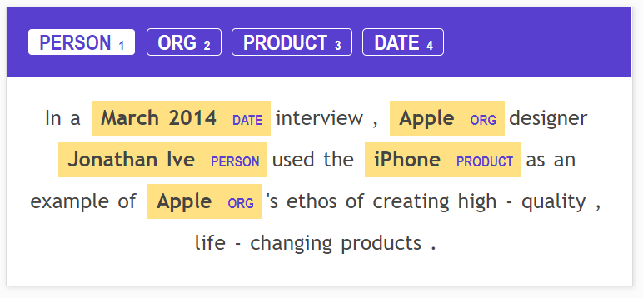
Ideas: Borehole extraction from text
- Custom entity recognition
- Annotate documents quickly with something like prodi.gy
  This service could also do the machine learning work, I would have tried it out in a heartbeat but licences cost a bit of money
- Can have a very flexible approach, able to annotate all kinds of entities/attributes
Source: https://prodi.gy/features/named-entity-recognition

Slide 9
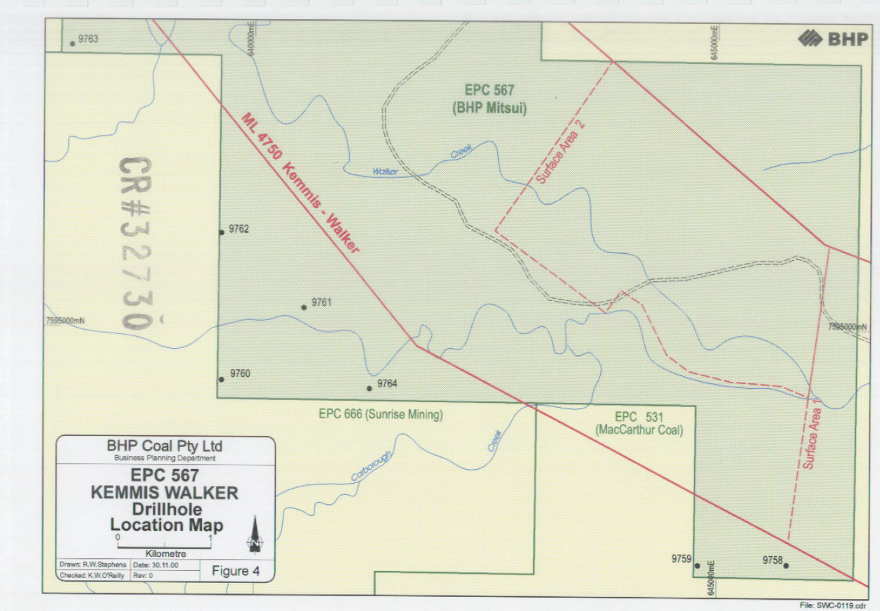
Borehole extraction from images
- Probably not necessary, also can be the hardest
Source: cr_32730_2.pdf

Slide 10
Will a report type contain boreholes?
YES | MAYBE | NO
Annual Report | Any Other Report | Acquisition Report
Annual Resource Authority Report | Any Other Resource Authority Report | Converted from QERD
Collaborative Drilling Initiative - Final (Completed) | Article | Cumulative Prod/CSG Water Readings - Petroleum
Collaborative Drilling Initiative - Final Report | ATP Other Report | Geothermal Production Reports
Collaborative Drilling Initiative - Proposals | Commissioned Industry Study or Report | Geothermal Injection Reports (None currently in QDEX)
Departmental Drilling | Geological Survey of Queensland Publication | Geothermal Injection Testing Reports (None currently in QDEX)
Final or End of Tenure Report | Geological Survey of Queensland Record | Geothermal Production Testing (None currently in QDEX)
Final Relinquishment (MDL) | Geophysical Survey Reports | Greenhouse Gas Injection Report (None currently in QDEX)
Geothermal Annual Reserves Reports | Industry Consultative Report | Greenhouse Gas Storage Injection Report (None currently in QDEX)
Hydraulic Fracturing Activity Report | Industry Network Initiative - Final (Completed) | Greenhouse Gas Stream Storage Capacity Report
Other Water Reports | Mineral Associated Water | Logistics Report
Partial Relinquishment Report | Petroleum Field Reports | Mine Plan Lodgement
Petroleum Non-Associated Water | Presentation | Performance Review Report
Queensland Government Mining Journal | Scientific or Technical survey Report | Petroleum Infrastructure Reports
Six Monthly Exploration Report | Soils & Land Resources | Petroleum Production Information (Good Practice)
Surrender Report | Technical Report | Petroleum Reserves and Resources Information (Good Practice)
Well Completion Report | Thesis | Production (Petroleum)
Well or Bore Abandonment Report |  | Reserves (Petroleum)
Well Production Testing Report |  | Seismic Reprocessing Report
Well proposal |  | Seismic Survey Final Report
Well Report Other |  | Seismic Survey Report Other
 |  | Transmission Report

